Slide 1
城市夜晚的颜色 Urban Night Colors
Keke Zhiyu Yiyan

Slide 2
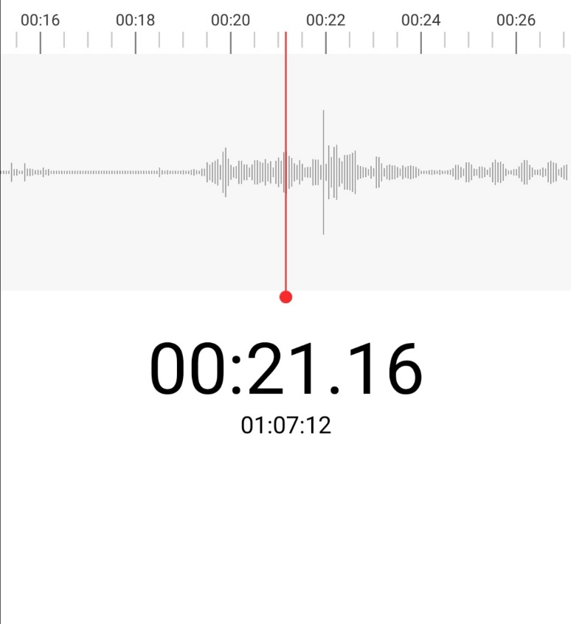
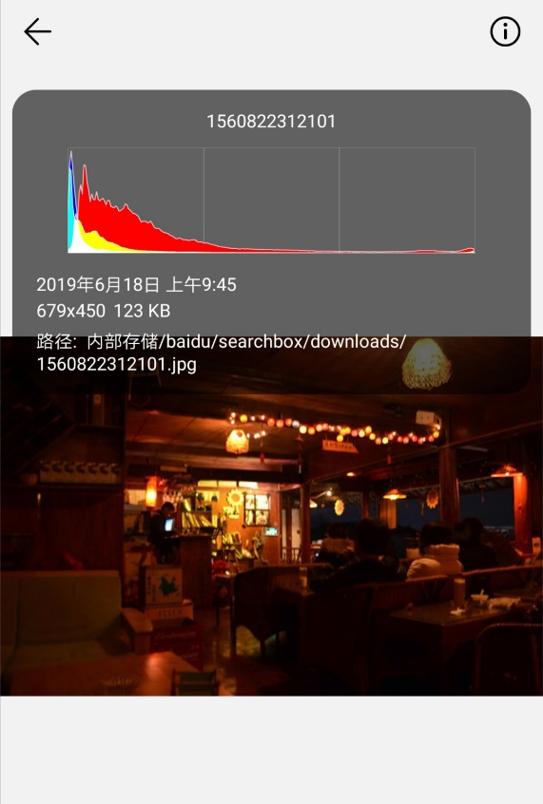
项目说明：
description of project
我们以城市夜晚的颜色为题，以不同的Club场所作为研究对象。
我们将从两个方向进行实地调研：
1.Club现场的音频曲线
2.Club现场拍摄的RGB曲线
We take the color of city night as the topic, and take different Club places as the research object.
We will conduct field research in two directions:
Audio Curve of Club Field
2. RGB curves captured by Club

Slide 3
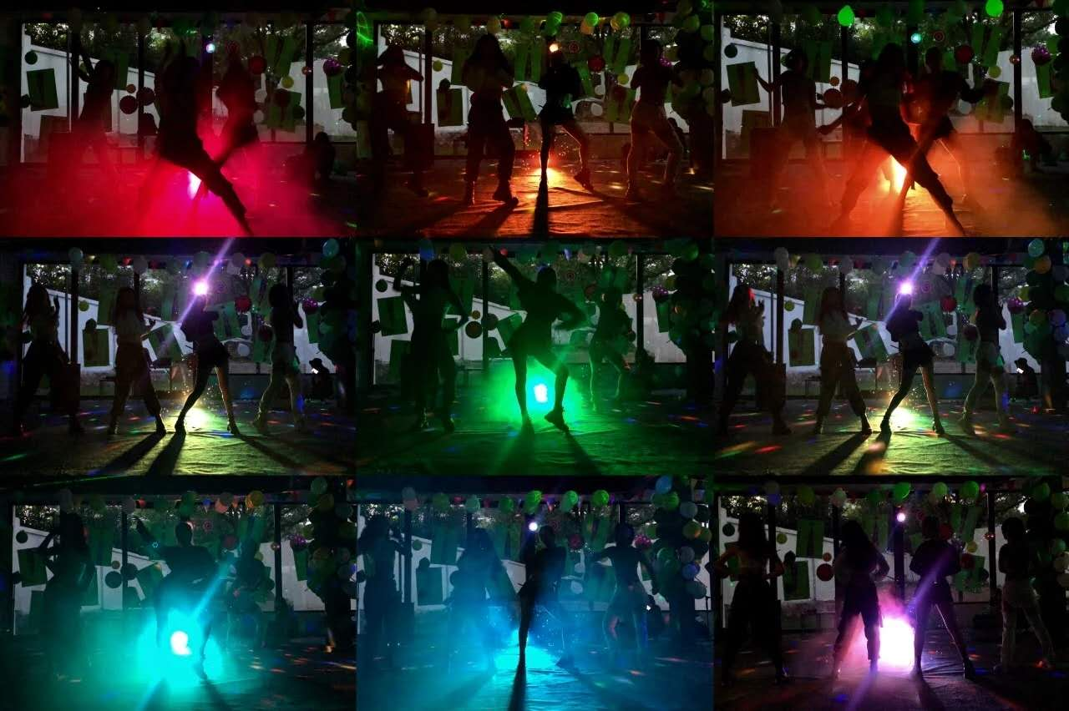
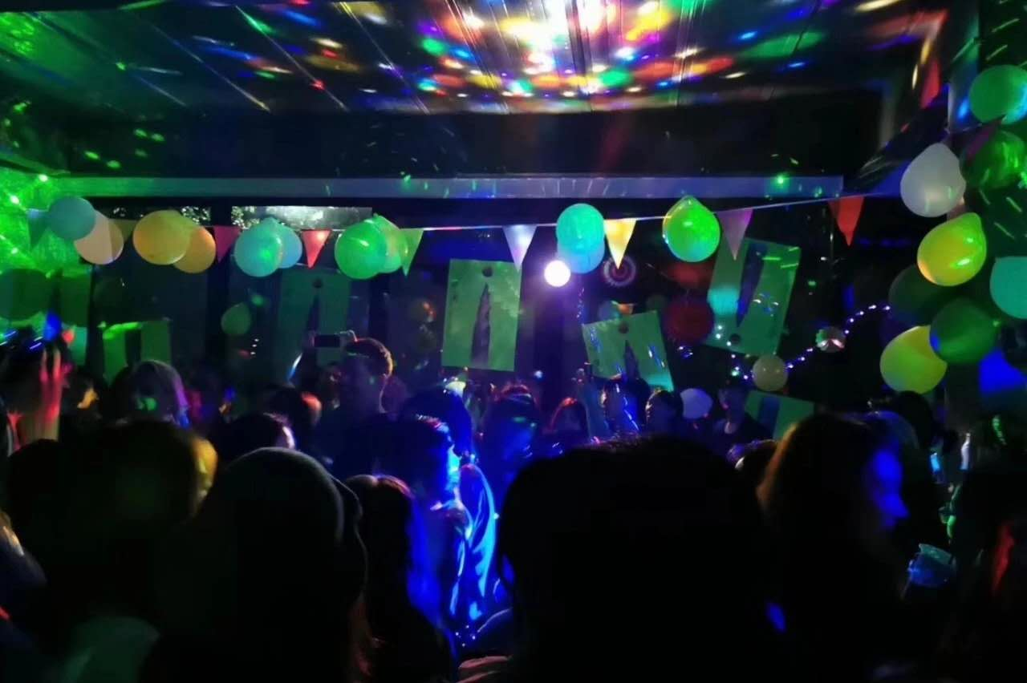
Inspiration
我们的灵感来源于上周五的PARTY，以及舒怀老师。其实无论对于哪一场Club来说，现场的灯光以及音效都是其受顾客青睐的亮点所在。所以我们决定对于Club现场的灯光以及音效进行数据可视化的制作，这也可以说是对于每个酒吧的用户研究。
Our inspiration came from PARTY last Friday.And Shuhuai teacher. In fact, for any Club, the lighting and sound effects on the scene are the highlights of its customers'favor.So we decided to study the visualization of lighting and sound production data on the Club site, which can also be said to be a user study for each Club.

Slide 4
我们将录制Club现场的音频曲线和拍摄Club现场的视频，再对其进行后期制作，提取出每一帧的曲线。
We will record the audio curve of Club scene and take the video of Club scene. Then we will post-produce it and extract the curve of each frame.

Slide 5
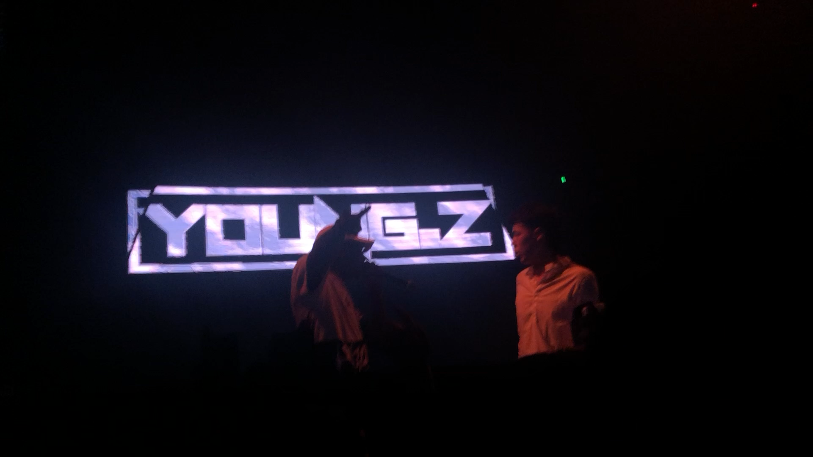
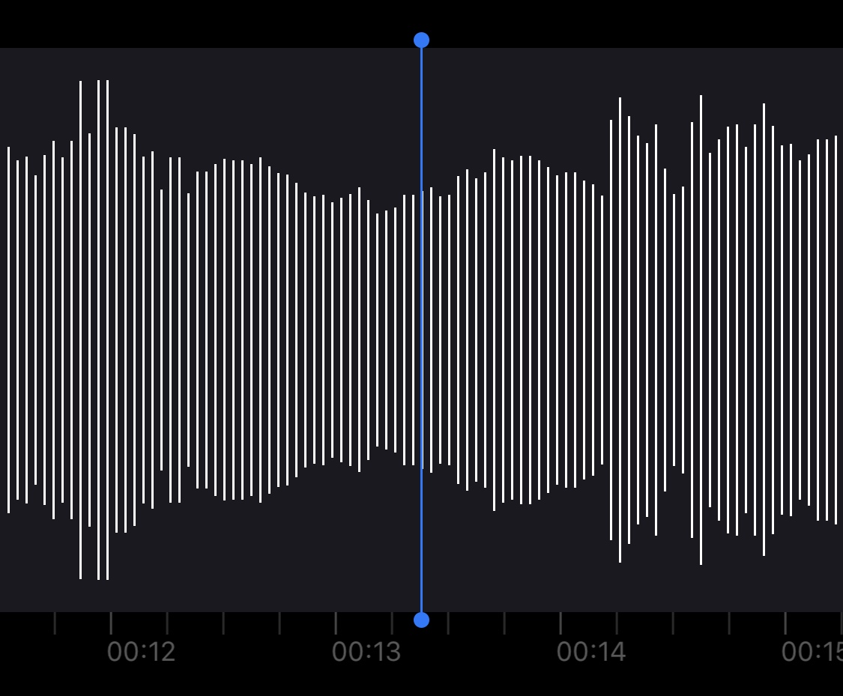
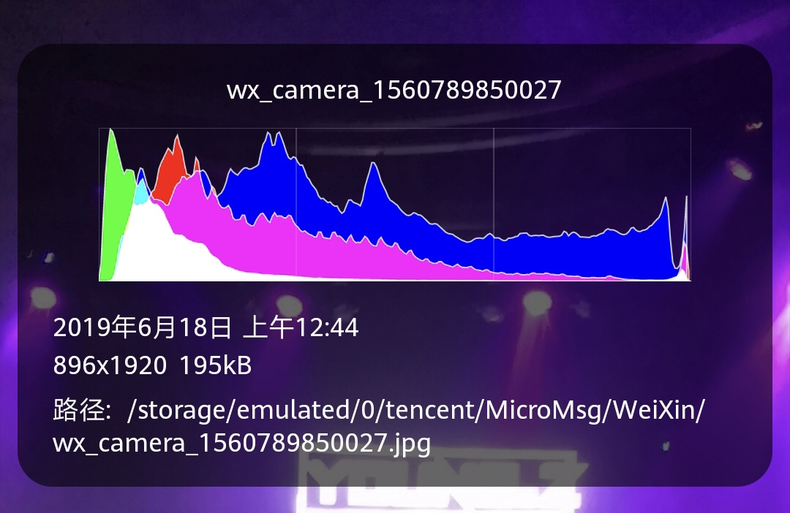

Slide 6
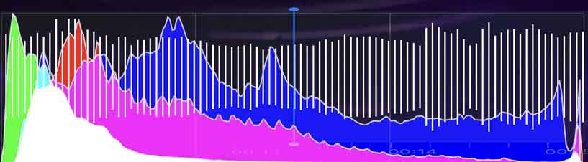


Slide 7
星期二：进行调查研究第一个Club，以及数据转换的实践尝试。
星期三：进行调查研究第二个Club，以及数据转换的实践尝试。
星期四：进行调查研究第三个Club，以及数据转换的实践尝试。
星期五：进行调查研究第二场Party，并整理数据，进行视频剪辑和音频转换。
星期末：提取帧数图像，进行RGB曲线的绘制。
星期一：开始音频曲线的视频制作。
星期二：开始RGB曲线的视频制作。
星期三：整合我们的视频，进行放映尝试。
Tuesday: Investigate and study the first Club and the practice of data conversion.
Wednesday: Investigate and study the second Club, as well as the practice of data conversion.
Thursday: Research the third Club and the practice of data conversion.
Fridays: Organize data, video clips and audio conversion.
Weekend: Extract frame number image and draw RGB curve.
Monday: Video production of audio curves will begin.
Tuesday: Video production of RGB curves will begin.
Wednesday: Integrating our shi'p

Slide 8
Thank you

